Slide 1



Slide 2

DHT11 SENSOR To tackle your heat related issues

Slide 3
What are the instruments we generally use to measure temperature?
And what about measuring humidity ?
Did you study about it in your school days ?

Slide 4
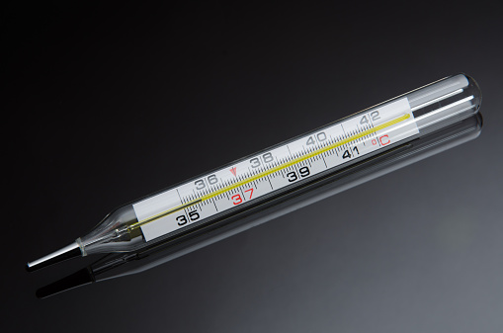
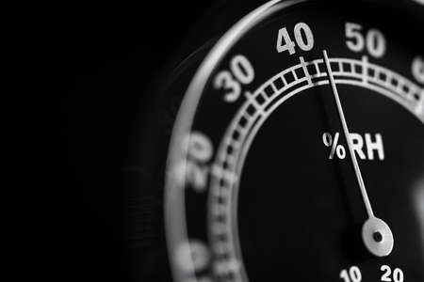
Thermometer Hygrometer

Slide 5
But, what if I say that there is one electronic device which can measure both temperature and humidity accurately?

Slide 6
That’s where the DHT11 sensor comes into play!

Slide 7
It is a sensor which you might not have heard about much, as compared to the previously explained sensors.

Slide 8


Slide 9
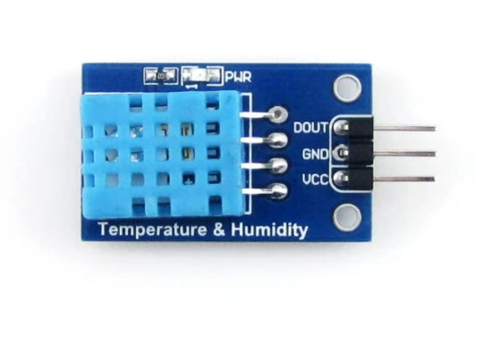
What is a DHT11 sensor ?
A DHT11 sensor basically measures both temperature and humidity of the surrounding.
It is small but has some complications.

Slide 10

What constitutes a DHT11 sensor ?
Capacitive Humidity Sensor
Thermistor
Analog to Digital Convertor
DHT11

Slide 11
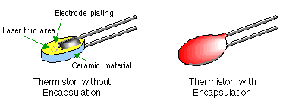
What is a Thermistor ?
Thermal + Resistor
Its made up of semiconductor metal oxide.
Enclosed in a layer of ceramic or polymers to increase sensitivity.

Slide 12
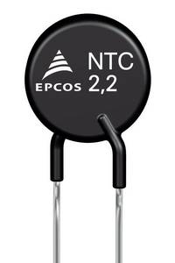
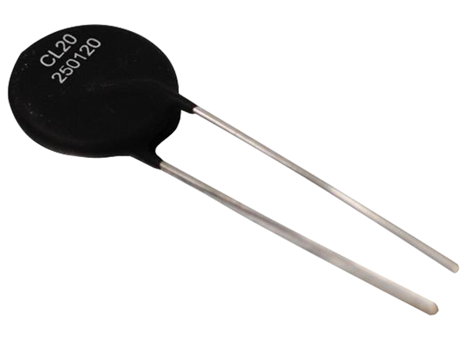
Two types of Thermistor
NTC- negative temperature coefficient thermistor.
PTC –positive temperature coefficient thermistor.

Slide 13
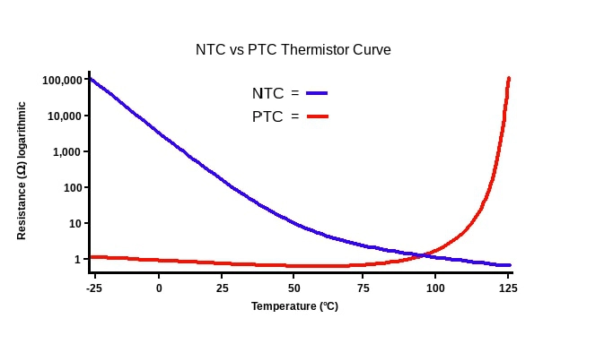
How NTC and PTC graphs vary ?

Slide 14
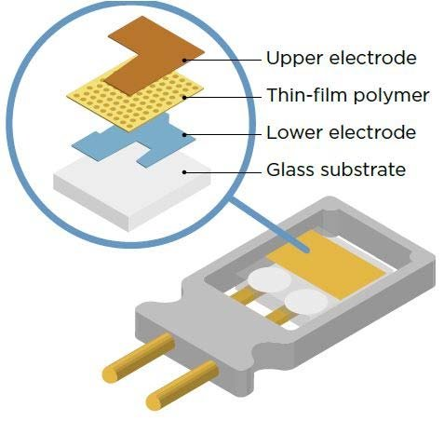
What is a Capacitive humidity Sensor ?
Made up of two metallic plates enclosing a layer of porous dielectric substance between them.
Measures water vapor level in environment.

Slide 15

How does the capacitive humidity sensor work ?

Slide 16
Lastly the Microcontroller IC which is present in the sensor converts the input analog signals to digital and likewise we get our outputs of humidity and temperature.

Slide 17
DHT11 VS DHT22
DHT11 | DHT22
Cheaper | Expensive
Less reliable | More reliable
1Hz sampling rate | 0.5 Hz sampling rate
Less temperature resistance | More temperature resistance

Slide 18
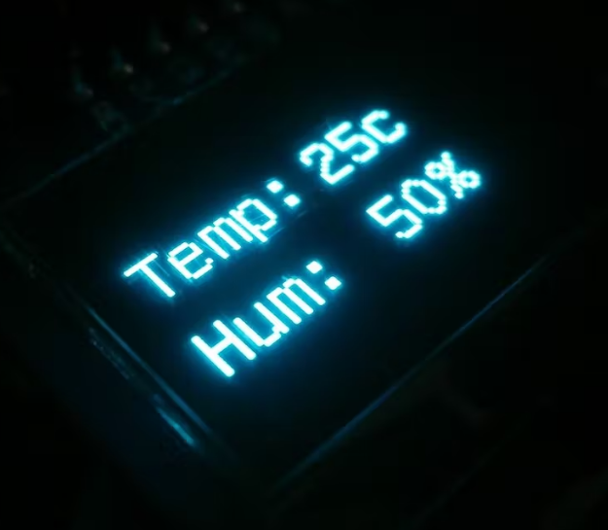
AAPPLICATIONS
Greenhouses
Weather forecasting
Household monitoring

Slide 19
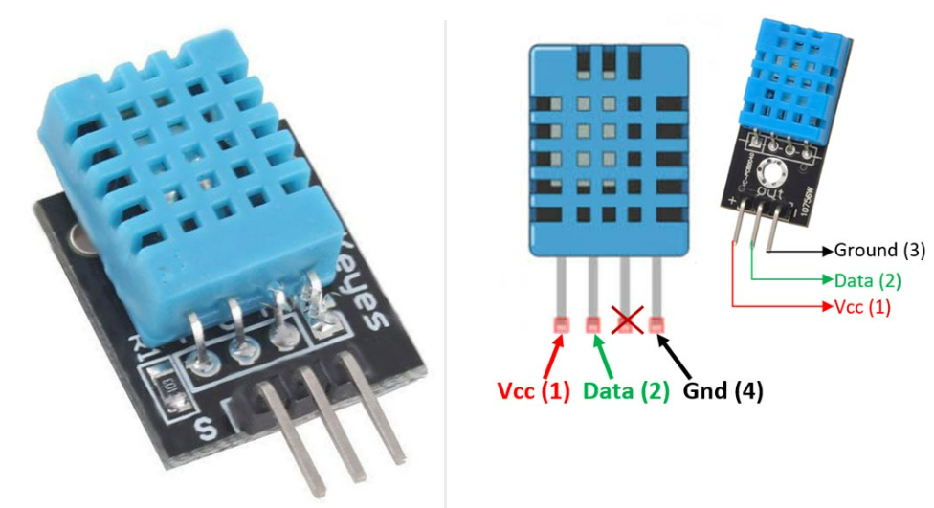
T
PIN LAYOUT

Slide 20
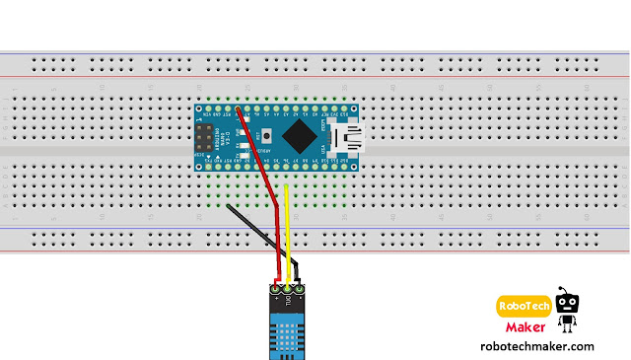
T
CIRCUIT DIAGRAM
-ve terminal
+ve terminal
Data pin
D6 port
5V Vcc
Ground pin

Slide 21
So are you guys ready for the exciting hands-on part ?

Slide 22
Code for the sensor

Slide 23
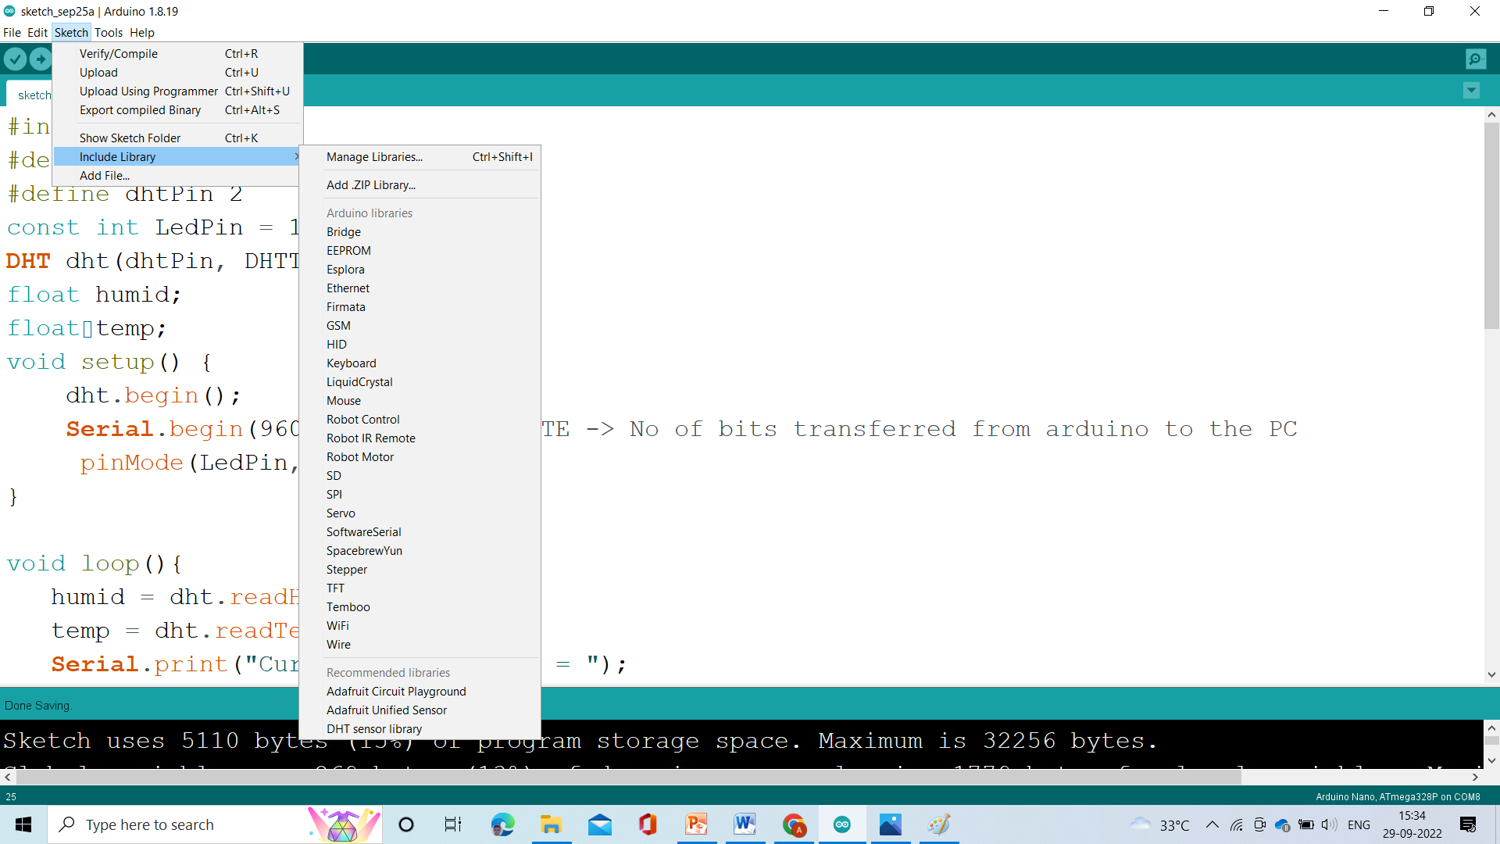
Please input the library now.

Slide 24
CODE
#include <DHT.h>
#define DHTTYPE DHT11
#define dhtPin 6
DHT dht(dhtPin, DHTTYPE);
float humid;
float temp;
void setup() {
dht.begin();
Serial.begin(9600); ///BAUD RATE -> No of bits transferred from arduino to the PC
}
void loop(){
humid = dht.readHumidity();
temp = dht.readTemperature();
Serial.print("Current Temperature = ");

Slide 25
Serial.println(temp);
//Serial.print("C ");
Serial.print('\n');
Serial.print("Current humidity = ");
Serial.println(humid);
//Serial.print(" % ");
Serial.print('\n');
delay(1000);}

Slide 26
T
THANK YOU !
Speakers:
Sidra Nasreen &
Abhinav Kar

